Slide 1





Studio Speaker
Training
TEMPLATE
Meeting Date: Month ##, Year
Event Date: Month ##, Year

Slide 2
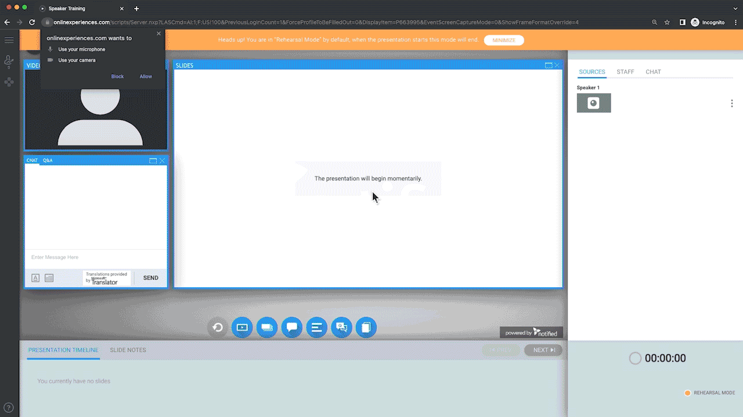

Slide 3
Agenda
Attendee View
Presenter View View
Q&A and Feature Review
Hardware & Connection Testing
Questions

Slide 4
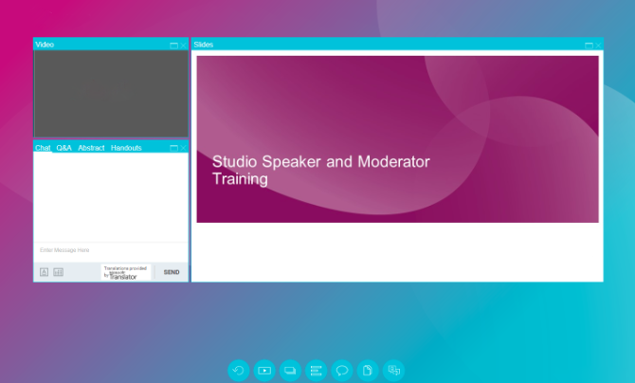
Attendee View
Attendees only see the branded webcast console and selected widgets such as:
Video/Media
Slides/Polling
Chat
Q&A
Abstract/Speaker Bio
Handouts

Slide 5
Customizing the Layout
All users may resize and move webcast panels without altering the view of others
Resize – click and drag on the corner of a window to resize
Move - Click and drag on the top bar to move a whole panel
Widgets - Each window is represented by a circular widget located at the bottom of the screen
Accidentally close a window? Reopen it by clicking the appropriate widget, or the Restore icon

Slide 6
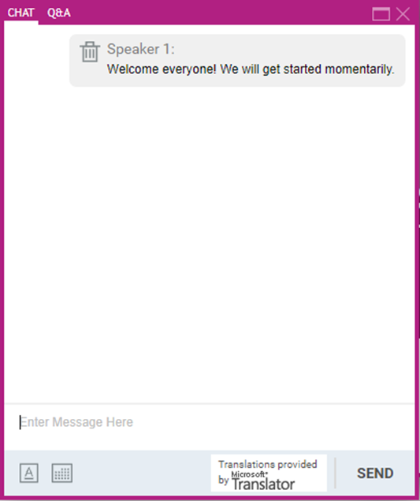
Public Chat
The Chat panel is a public chat box for all webcast users
Anything typed in this area can be seen by everybody who is logged into the webcast, including staffers and attendees
Exiting and re-entering the Studio console will clear the chat contents for a user’s local view
Users can change their font and text size/color/formatting if desired

Slide 7
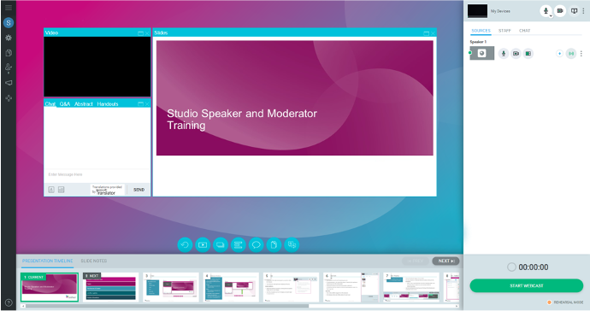


Backend View
Start Screen Share
Hide/Unhide Video
Mute/Unmute Audio
The backend view of Studio is seen by all staffer types​ except viewers. Each user type will have slightly different rights and can be altered upon request.
Right Panel
  My Devices
  Sources
  Staff
  Chat
Minimizing Panels
Timer
Rehearsal/Live Mode Indicator
Hover cursor along borders

Slide 8
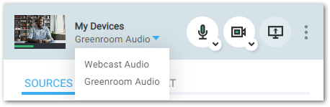
Greenroom
Greenroom is a feature available on Studio webcasts that allows presenters, moderators, and other webcast staff to gather and verbally communicate in a private virtual space prior to joining or during a live webcast.
Greenroom is an audio-only line. To toggle between Greenroom and Webcast Audio, click on the drop-down in the My Devices menu. The option you select will dictate which “room” or audio feed is heard. The volume of both the Webcast Audio and Greenroom Audio can be adjusted using the existing volume controls within the Media Player panel in the layout.
During the webcast, Greenroom acts as a separate communication line for you to privately interact with active sources while the live webcast is ongoing. This means you can seamlessly coordinate with your team members and ensure a smooth flow of communication throughout the entire webcast.
Please Note: The Greenroom feature is available for Webcam and Phone sources only and is only available to staffers with the Auto-Ask for Webcam/Mic permission enabled in their staffer settings. If this setting is unavailable in your source settings, reach out to your webcast administrator.

Slide 9
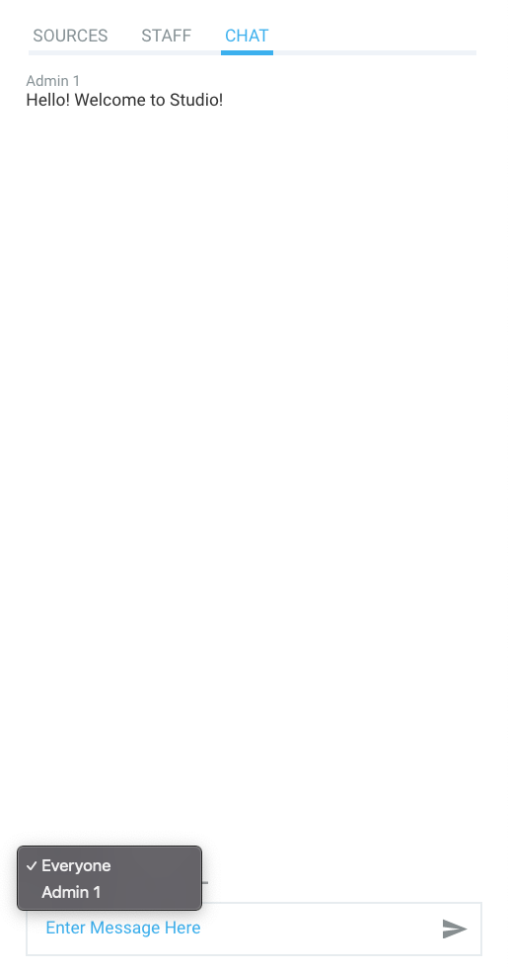
Backend Chat
The Backend Chat can be used to communicate with anybody who is logged into the webcast as a staffer
It is a great way to communicate with individual backend users or all staffers
Like the Public Chat, the contents will be cleared when a user exits and re-enters the platform
Feel free to type in a test message!

Slide 10
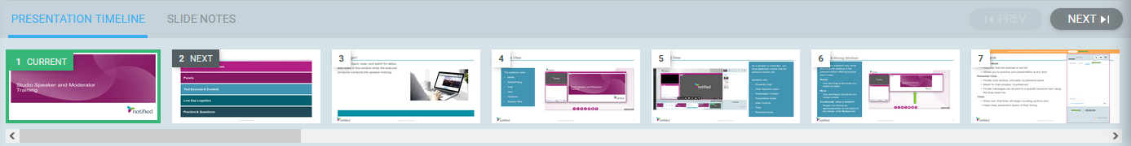
Presentation Timeline
The Presentation Timeline is located at the bottom of the Studio Console
Pro Tip: Use standard fonts and delete automatic slide timings from your deck prior
to submitting for upload Click Here for more best practices.
Use the PREV/NEXT buttons to move through slides
Note: All presenters have access to advance slides. If one presenter advances a slide, all users will see the slide advance.
You may advance to specific slides by double-clicking on the thumbnail
Note: This is recommended only when skipping slides. Use the PREV/NEXT buttons as your primary means of advancing slides
You may also see slide notes that were saved in the PPT deck.
Note: These cannot be resized or moved

Slide 11
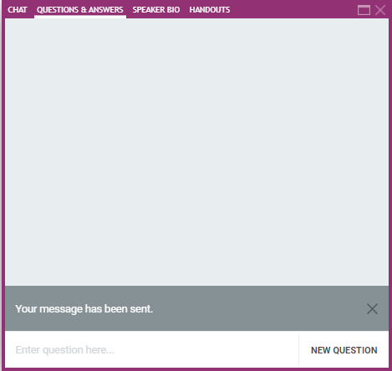
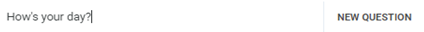
Q&A Panel
Attendee View
Attendee Q&A Experience
Attendees can submit text questions any time during the webcast
Attendees receive a “Your message has been sent.” notification when submitting a text question
Note: Attendees will not see the questions of other attendees

Slide 12
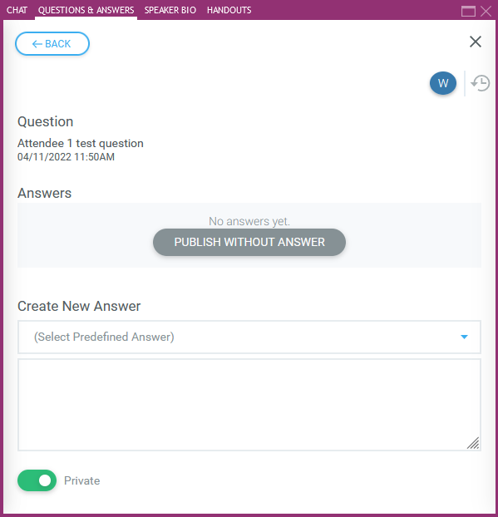
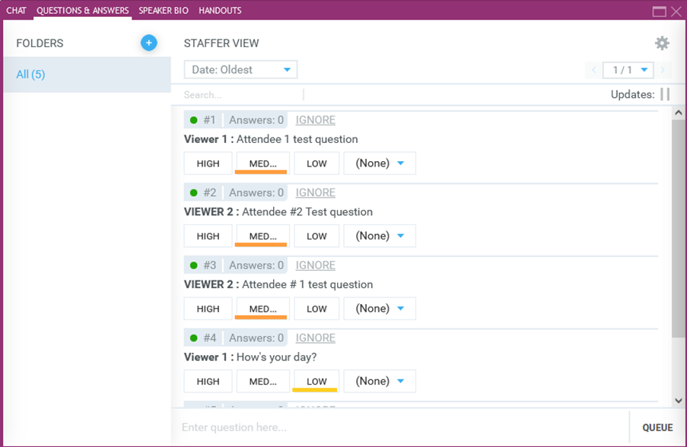
Q&A Panel
Backend View
Sorting Questions - HIGH/MED/LOW Prioritization
HIGH: Questions pushed to top
MED: Questions in middle (default)
LOW: Questions pushed to bottom
Queue
Add your own questions to the list
Edit Answer Window
Click on a question to show options for answering

Slide 13
Q&A Panel
Answering Questions
Responding to Questions
Type a custom message or use one of Studio’s predefined answers
Publish Without Answer
Makes question visible to entire audience without a response
Private Toggle Switch
Response will only be visible to the attendee who sent the question
Uncheck to make question and answer viewable to audience
Please Note: Technical questions will be handled by your webcast producer

Slide 14
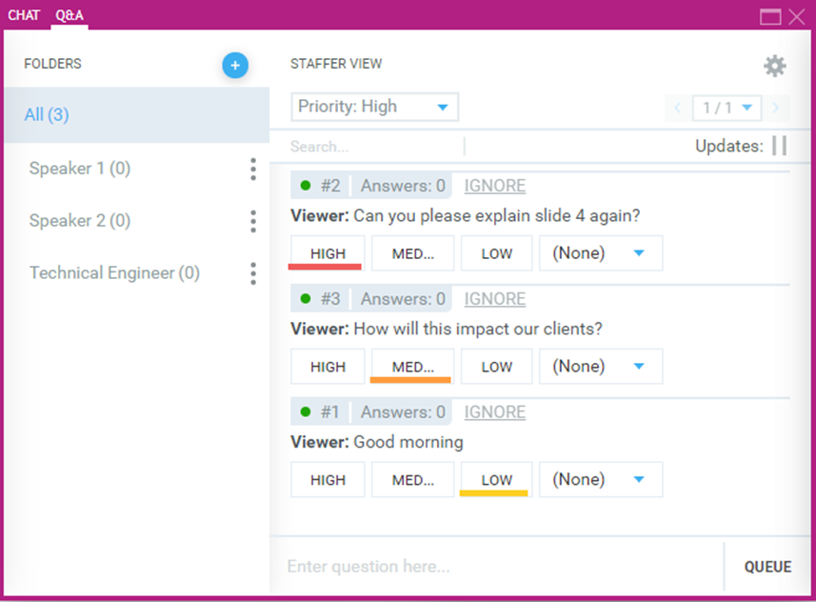
Q&A Panel
Backend View Continued
Pages
Each page can only hold 10 questions
Click the arrow to move between pages
Ignore
Question will be grayed out but still visible
on the list
HIGH/MED/LOW prioritizations will still be followed
Folders
Can be used to sort questions into categories
EX: Create folders by subject or person that will address them

Slide 15
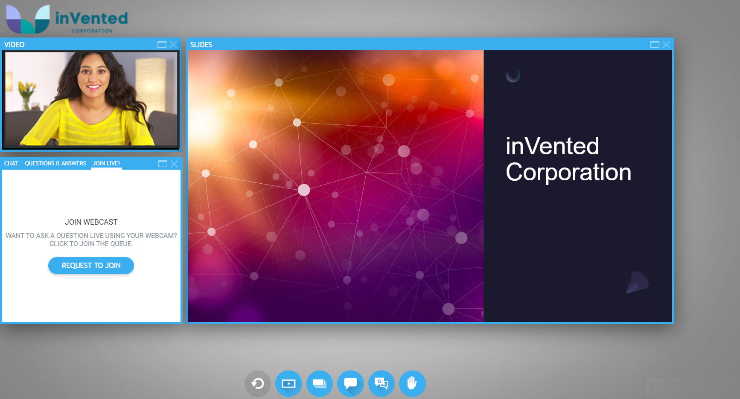
Promote Attendee to Stage Overview
The Promote Attendee to Stage panel provides attendees the ability to request to join presenters on webcam/microphone to ask questions & provide their thoughts during a Live webcast.

Slide 16
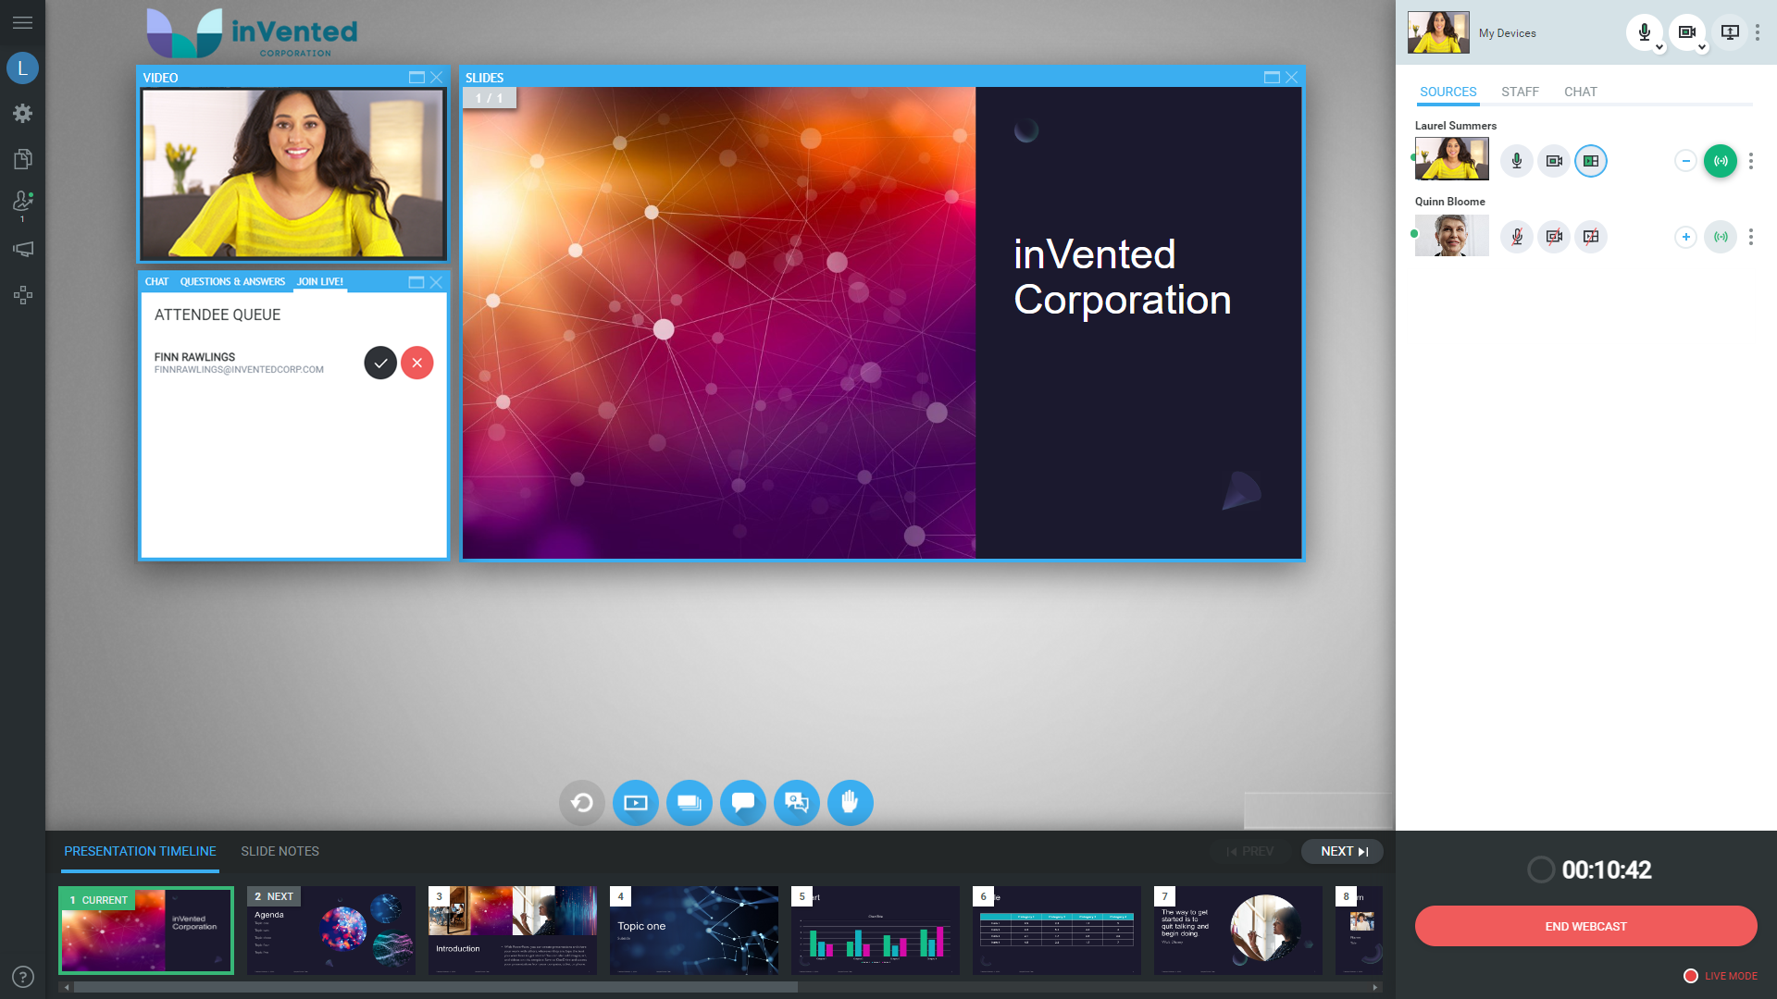
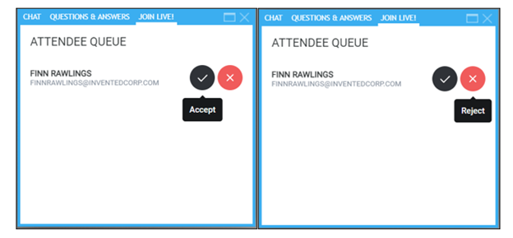
Promote Attendee to Stage
Accepting & Rejecting Requests
When a Request to Join is submitted, Speakers will Accept or Reject requests.
Rejected requests will remove Attendees from the Attendee Queue panel.
Attendees can click the Cancel Request button to remove themselves from the requested list. Attendees can elect to join the queue again after withdrawing their request.

Slide 17
Promote Attendee to Stage – Speaker Flow
Pre-Live
The Webcast Producer will review Accepting/Rejecting requests with Speakers & Moderators.
  Speakers & Moderators will determine who on their team will Accept/Request requests.
  Speakers & Moderators will determine when they will take questions during the presentation.
Live
Attendees select the Request to Join button to ask a question Live.
Speakers & Moderators will monitor the request queue to Accept/Reject requests.
When verbally prompted, the Webcast Producer will add/remove Attendees from the Scene.
Speakers & Moderators will return the Attendee back to the Audience.

Slide 18
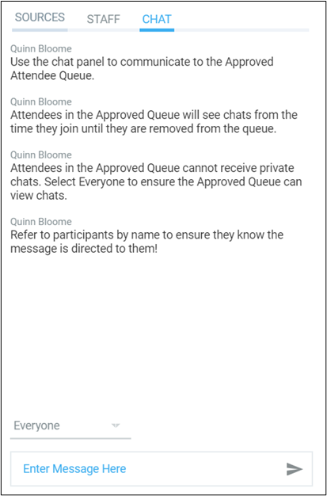
Communicating with Approved Queue
Chat
When Attendees are added to the Approved Queue, a private Chat connected directly to the Speakers & Moderators is available.
Attendees can expect Speakers & Moderators to engage with them & all other users in the Approved queue in this chat.
Verbal Alerts
When Speakers are ready to Add an Accepted request into the Scene, they should verbally alert the Admin user to add the Attendee to the scene. As a best practice, work with Speakers in advance of the webcast to determine a key phrase to add an Attendee to the scene.

Slide 19
Promote Attendee to Stage
Best Practices
Speakers & Moderators are responsible for Accepting & Rejecting Attendee requests in the Presenter Console.
As a best practice, assign 1 or 2 Speakers/Moderators to manage the Promote to Attendee queue.

Slide 20



Hardware & Connection Testing
Your Producer will now test all Audio and Video sources
Slides
Media
Devices

Slide 21
Live Day
Logistics & Questions

Slide 22
Best Practices
Tips for a successful webcast
Carefully read the instructions in the live day calendar invite
Hardwired internet connection is preferred over Wi-Fi
Be in a quiet space (silence notifications of cell phones, computers, etc.)
If you’re at home, ask others to reduce their internet usage to increase your bandwidth
Close other applications and browser tabs on your device
Enter your phone number in case we need to call your phone as a backup
Have an accessible version of your PowerPoint on hand
Click Here for more best practices

Slide 23
Questions?
CONTACT
Please contact [Contact Name] at email@brandlive.com

Slide 24
The future of work is now streaming on Brandlive
TEMPLATE

